Slide 1
COMPLETE FS ADVISER EVENT · 21 OCTOBER 2026
Who does Google put in front of your next client?
What 49 searches across Southampton revealed about the map, the machine, and who gets the call
Marc Heighway, FIMA Digital Ltd
Notes:
DON’T READ FROM THE SCREEN – let them read it
Morning everyone. Thank you to Damian and the Complete FS team for having me. I've got twenty minutes, and I'm going to spend nineteen of them giving you things you can use, and possibly about one minute at the end telling you how I can help.
I hope that sounds like a good deal?
My aim is to ensure that you will know more about how google search worls than the majority advisers…

Slide 2

^{Tuesday, 23:30}
35
Professional
Renting
Notes:
Let’s start with someone you haven't met yet.
It’s Tuesday, 23:30 – so last night.
She’s 35, professional, and renting. Her landlord has just put the rent up again.
….she picks up her phone and types:

Slide 3
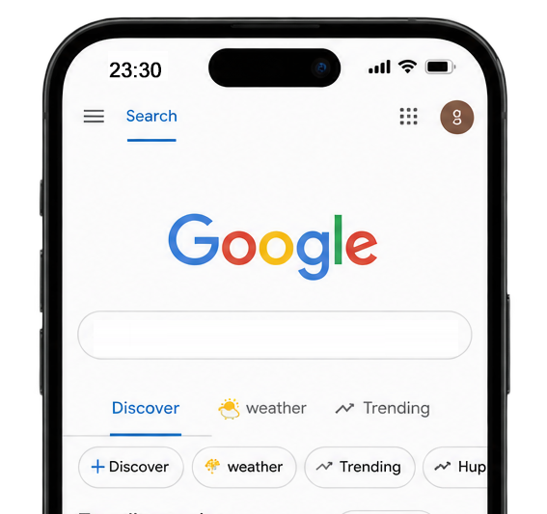



3
Mortgage broker southampton
Notes:
By the time she finally types "mortgage adviser Southampton", she's already had a ten-question conversation about her mortgage. She has opinions. She has a shortlist forming in her head.
So the question this morning is simple: were you part of that conversation?
And Google shows her a map - And were you one of the three names?

Slide 4

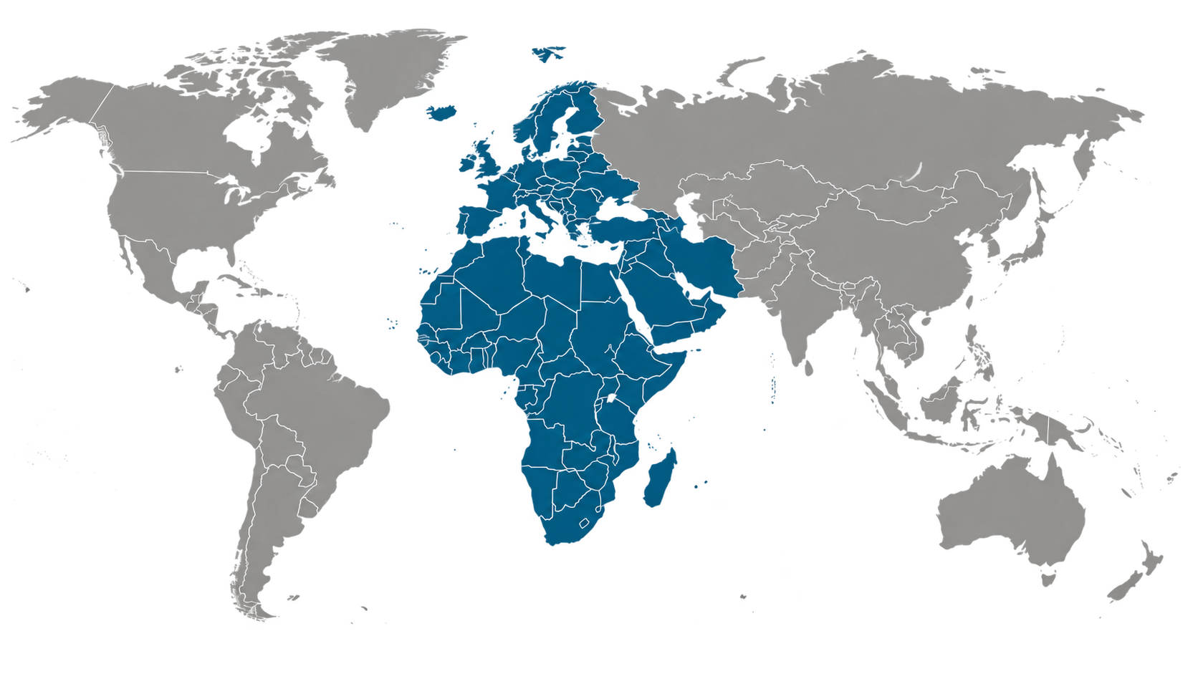
25 years
Garmin
Now just me…
Notes:
Quickly, who I am. I've worked in search marketing for about twenty-five years. Before I set up my consultancy, FIMA Digital, I ran online marketing for Garmin across Europe, the Middle East and Africa. These days I help local service businesses with one thing, which is being found. Increasingly, that means being found by Google's AI and not just by Google.
CLICK
In my spare time I'm a local historian. That mostly means spending weekends in muddy fields in the New Forest looking for bits of crashed wartime aircraft.
So I'm very comfortable telling people things about the past they'd rather not hear.
This morning I'm going to do it about the present and what is happening TODAY.

Slide 5
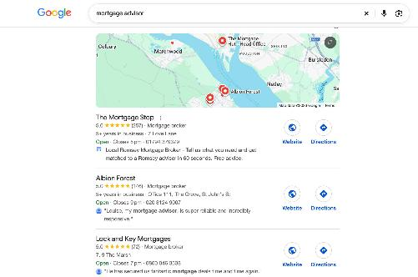
^{THE SHIFT IN SEARCH}
There are now two Googles
The search engine change
Longer questions: "do I need a broker?" Google's AI writes the answer, with sources, so she decides to start who to trust, often before she even reaches the map.
Notes:
Here's the shift. There are now two Googles.
The first is the map. Short searches, like "mortgage adviser", get a map with three businesses on it.
That's the one that decides who gets the phone call today.
The second is the search engine… which has changed. Longer questions, like the ones she was asking at eleven o'clock, increasingly get an answer written by Google's AI, with a handful of sources underneath. That's the one that's starting to decide who she trusts before she ever reaches the map.
I'm going to show you what both of them look like in Southampton right now

Slide 6
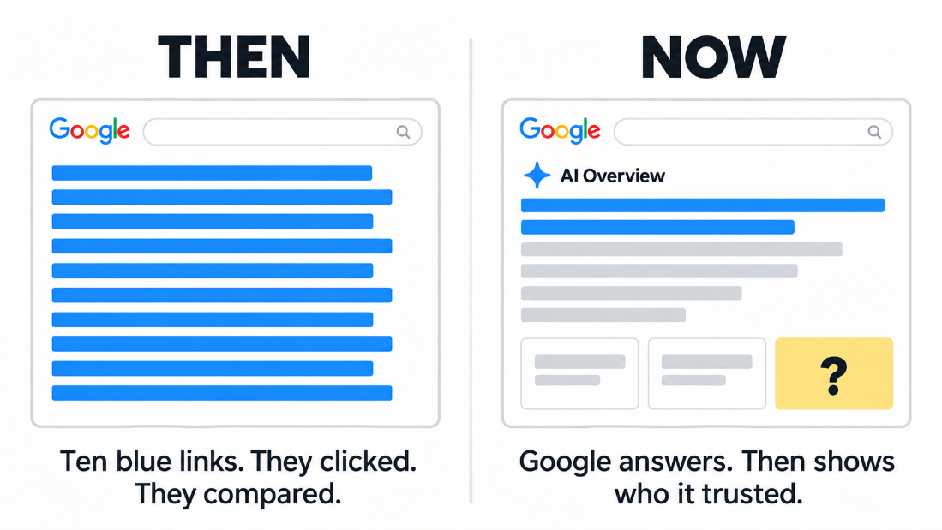
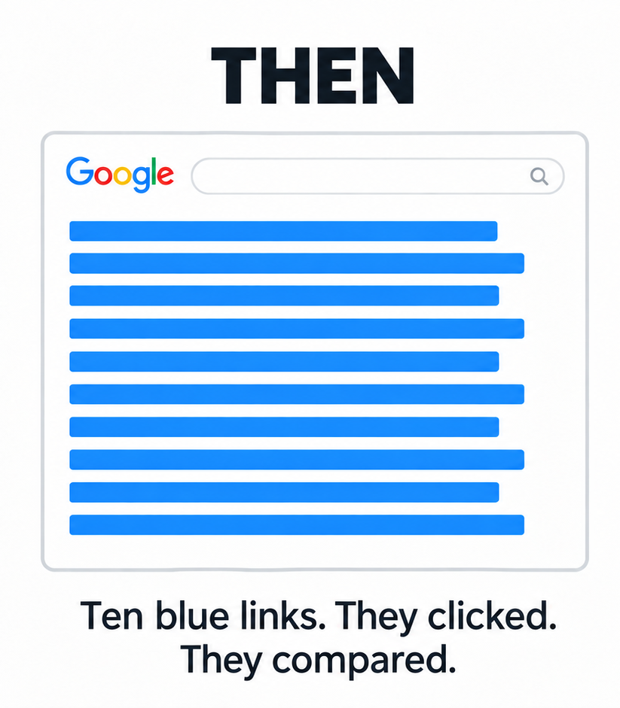
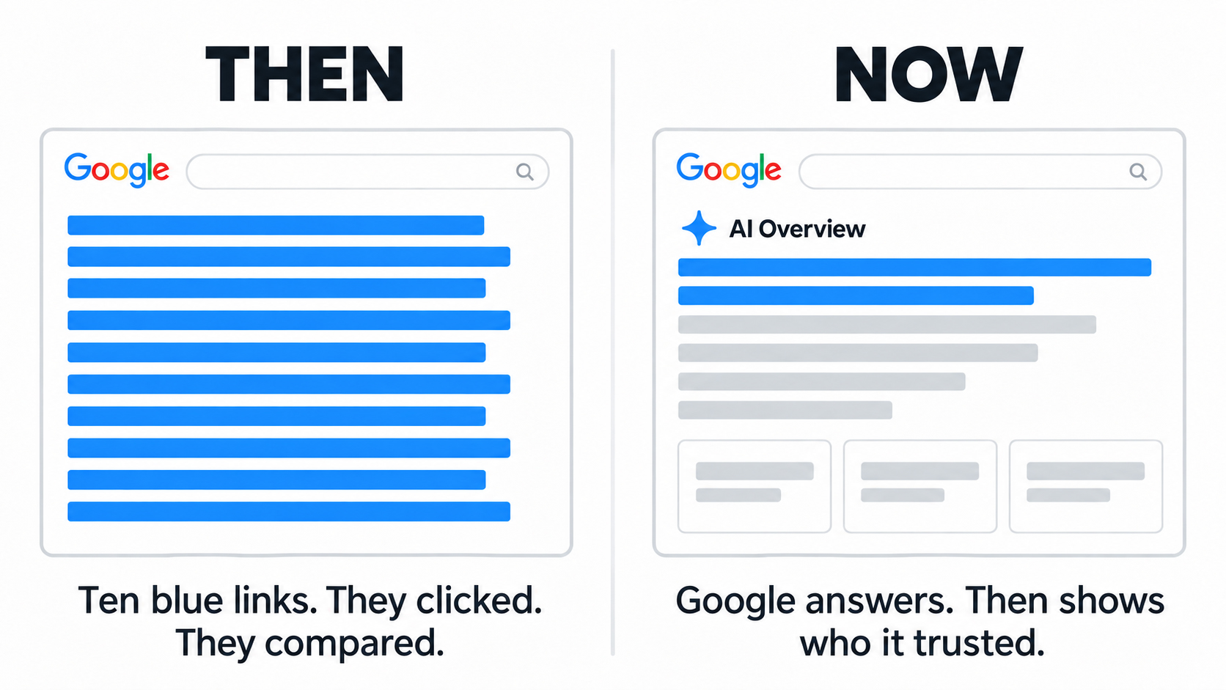
20 Years
Notes:
It didn’t use to be like this - for twenty years, search meant ten blue links. You fought to be on page one and people clicked through to decide.
Now, for questions like these, the ones on the screen and the ones your clients ask you every week, Google often writes the answer itself. It's called an AI Overview. Underneath it, Google shows a handful of sources: "this is where I got this from.”
Those sources are the new page one. If you're cited, Google is standing next to your client saying, "I asked this firm." If you're not cited, you're not in the room.
{The yellow "?" card plants the question the whole talk answers: whose name belongs there? That sets up the reveal on slide 7.}

Slide 7
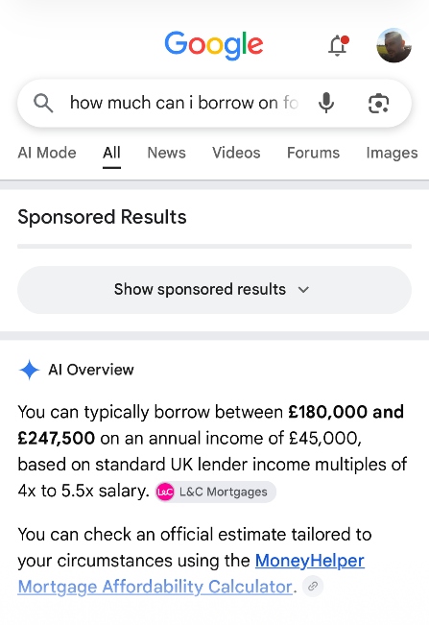
^{Google, October 2026}
Your client reads the answer.
The sources decide who they trust.
But what does it look like in Southampton? Let’s start with map results first..
Notes:
Here’s an example - If you've not looked closely at one, this is what it looks like. There's the answer at the top, written in plain English, and there are the little source cards beside it. They don’t need to click through to a website.
Your client reads the answer. The source cards decide who they trust.
I'm going to show you what both of them look like in Southampton right now.
Starting with this room.

Slide 8
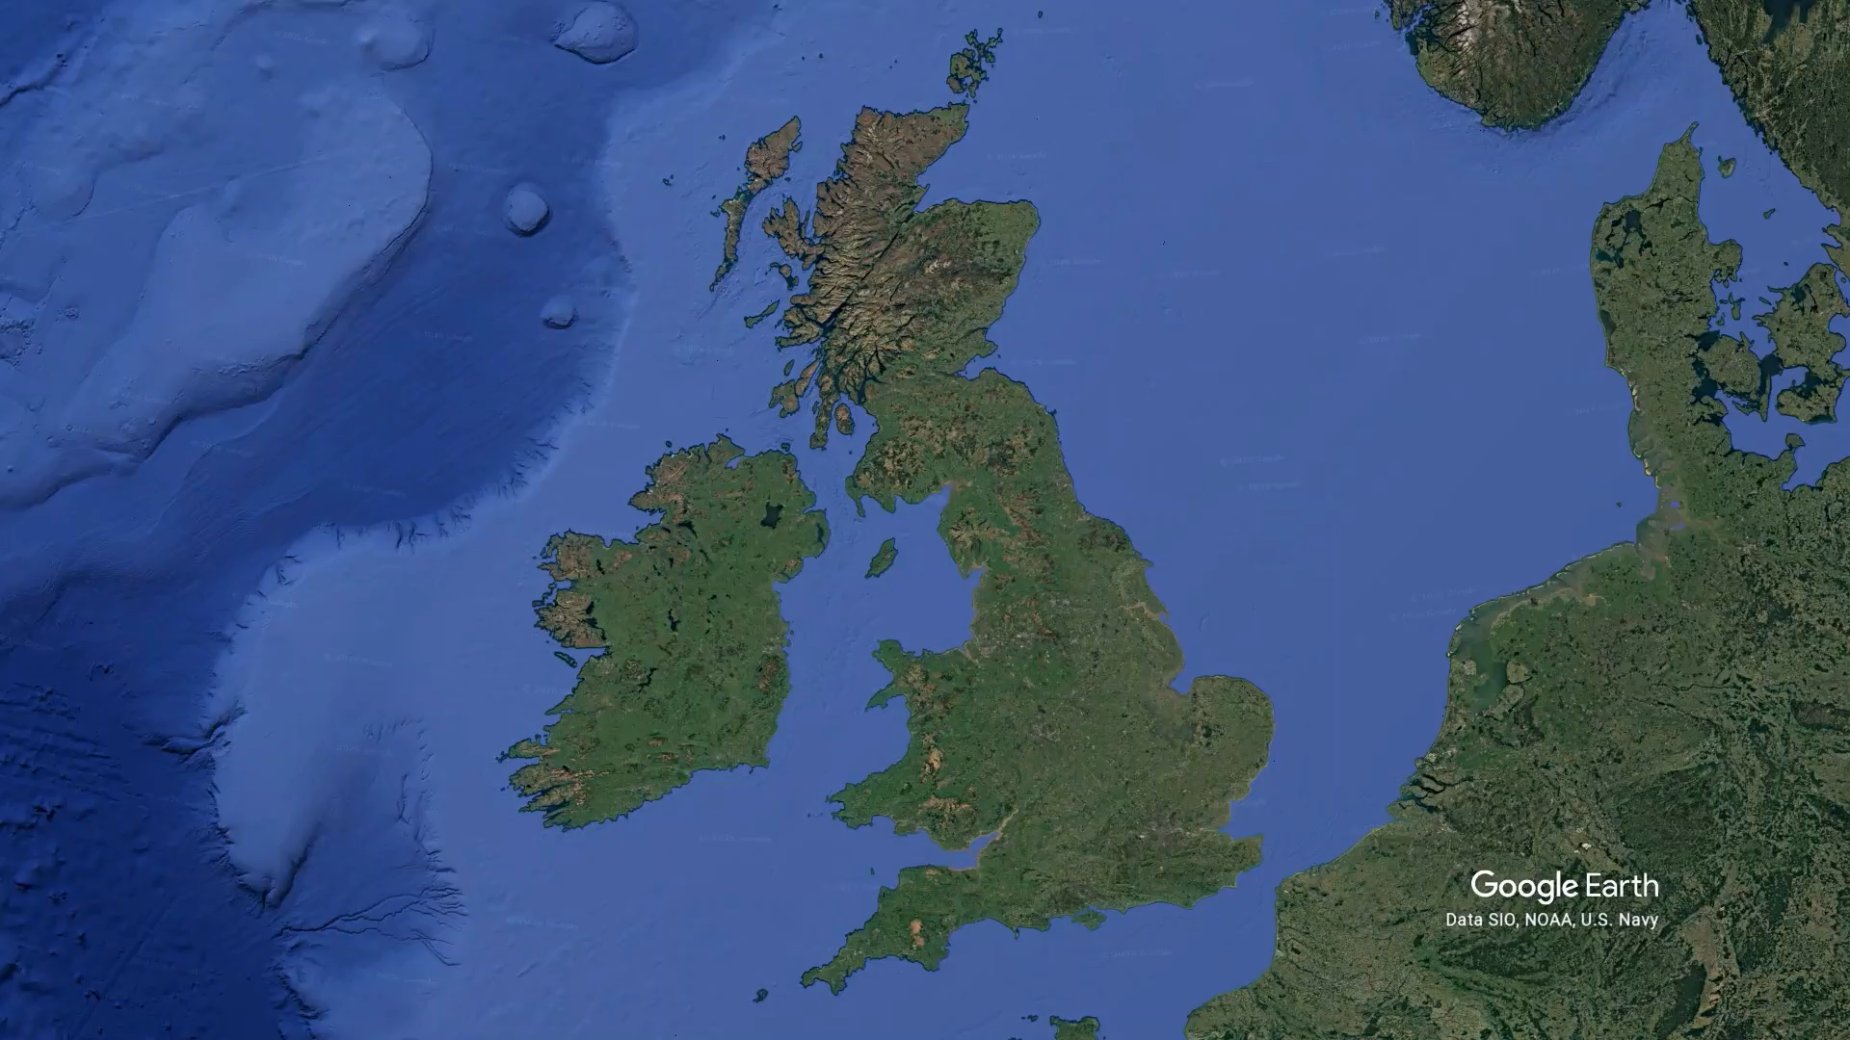
Notes:
But let’s start with the map results first…
Yesterday I ran a test on four points.

Slide 9
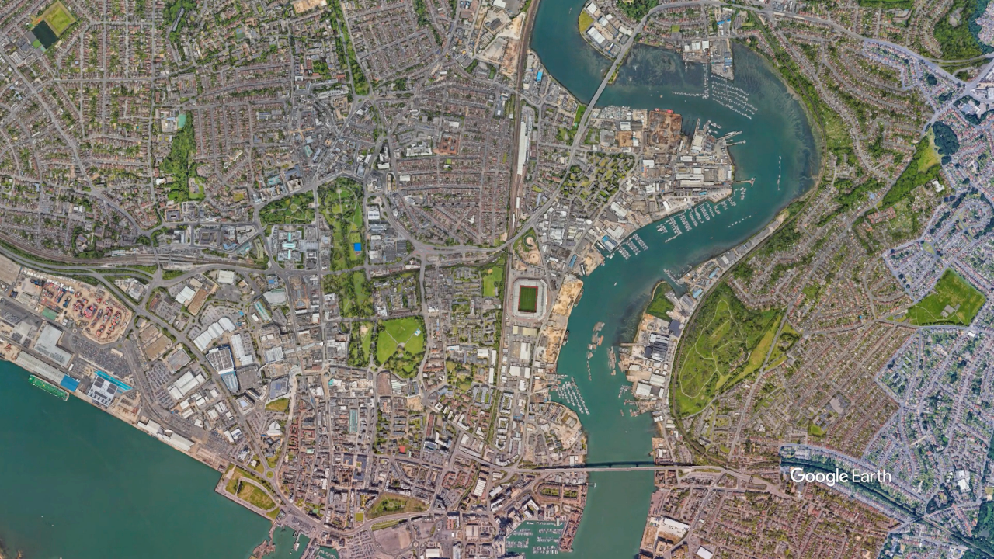

Notes:
I made searches from all 4 locations you see here
These are the four points from my scan around this stadium.
They're a mile apart from each other, and all within a mile of where you're sitting. Same search, "mortgage adviser".

Slide 10
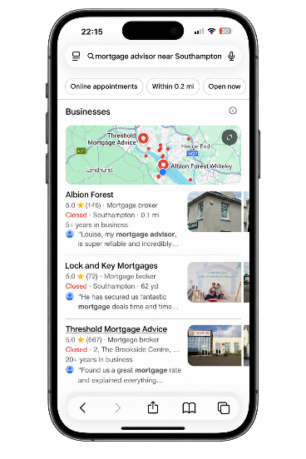



^{WITHIN A MILE OF THIS ROOM}
Four points around St Mary's, a mile apart. Four different top threes.
2m
0.4 mi north-east
0.8 mi south-east
0.8 mi north-west
1.0 mi south-west
1
Firm A
1
Firm A
1
Firm B
1
Firm D
2
Firm C
2
Firm E
2
Firm F
2
Firm A
3
Firm B
3
Firm D
3
Firm C
3
Firm B
6 different firms. Same search. All within a mile of this room.
Notes:
This is the type of result you will see.
But from those locations a mile away from where we are, this is the top three Google showed at each one.
[point across them] Four different top threes. Six different firms sharing those spots. Firm A: top of the list here and here, second over there, and gone completely on this one.
The map shows you the firms nearest to where the searcher is standing.
So if you check from your office, you'll probably look fine. Two miles away, it can be a completely different story.
Which means checking one phone tells you almost nothing.

Slide 11
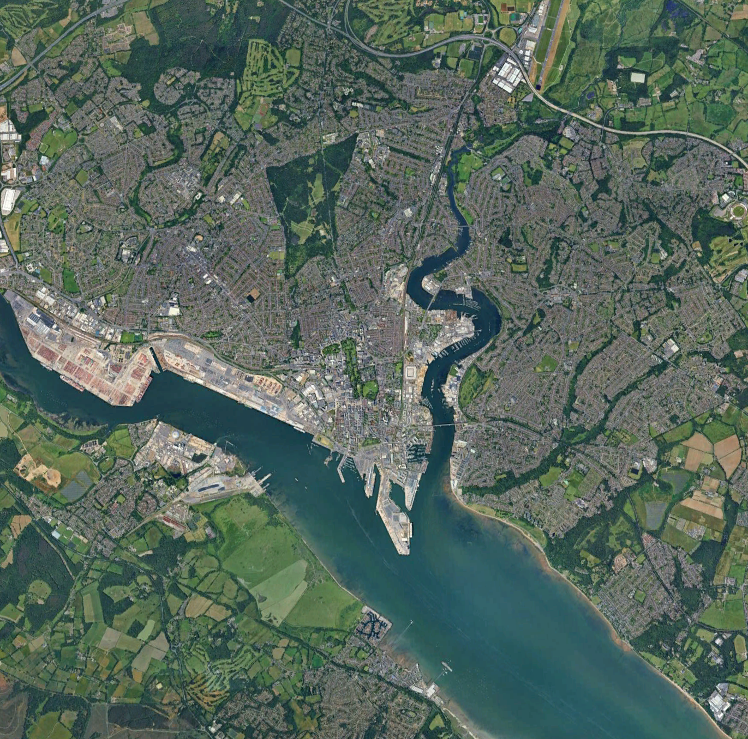
^{THE EXPERIMENT}
49 points, each a mile apart & 2 searches.
Imagine 49 people
points in a grid, each a mile from the next
6 miles
across Southampton
2 searches
"mortgage adviser" and a real client question
Process using specialist search tools. Repeatable, methodical system, anywhere in UK
Notes:
Over the last few weeks I've been running lots of tests like this. 49 points in a grid across the city, each one a mile from the next, six miles edge to edge. Picture forty-nine people spread across Southampton, all searching at the same moment.
I ran two searches. The two-word one, "mortgage adviser". And a real client question, which I'll come to.
At every point we recorded who appeared on the map, and what Google's AI said, if it said anything at all.
This is a process I've built on specialist local search tools. It's methodical and repeatable, which matters, because it means we can run it again and measure exactly what's changed.
And as you'll see, things change.

Slide 12
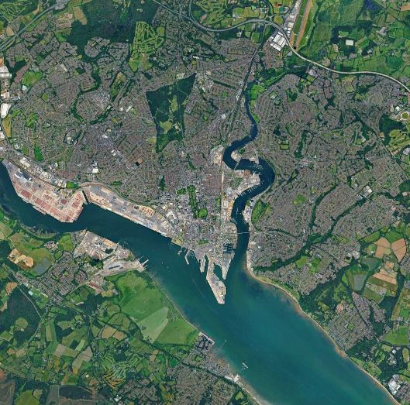
^{THE MAP}
27
different firms make Google's top three somewhere in Southampton
The top three changes from area to area
Nobody owns the city…
…except one firm
Notes:
First, the map.
Across those forty-nine points, twenty-seven different firms made Google's top three somewhere. The three names people actually see. The top three changes from one area to the next.
[If challenged: over sixty firms appear somewhere further down the list, but almost nobody scrolls past the top three.]
It's a fragmented market. Nobody owns the city.
Well. Almost nobody.

Slide 13
^{THE MAP – WHO WINS}
51%
of Southampton, John Charcol is in the top three
A national firm
Next best firm: 37%, then around 24%
Not better advisors, just done their Google homework
Yellow = top three at that point (25 of 49)
Notes:
John Charcol, a national firm, is in the top three at fifty-one per cent of the city. Half of Southampton.
The next best firm manages thirty-seven per cent. After that, it drops to around a quarter.
That's not because they're better advisers than you. It's because they've done the homework Google marks.
And the homework can be learned.

Slide 14
THE MAP – A REAL SOUTHAMPTON FIRM
7 of 49
points where this firm makes the top three
5.0 rating from 71 reviews
Well established
Average position: about 7th
Does anyone know or checked if their map is better than this, no matter your location?
Yellow = top three at that point (7 of 49)
Notes:
Now here's a real Southampton firm. A good firm. Seventy-one reviews, a perfect five-point-oh rating, been around for years. I'm not going to name them. They're not a case study. They're a mirror.
Yellow means they're in the top three at that point. Grey means they're not.
Their average position across the city is about seventh. They're in the top three at seven points out of forty-nine. Stand near their office and they're winning. At the other forty-two points, they're not one of the three names.
Be honest. How many of you think your map looks better than this?
How many of you have actually checked?

Slide 15

^{THE MAP – THE HARD TRUTH}
Reviews alone don't win the map.
one firm with..
1,350 reviews
yet top three at just 2 of 49 points
Google weighs relevance, distance and prominence
Reviews are one signal, not the whole answer
I will give you a checklist later
Notes:
And here's the part that surprises people.
One firm in this scan has thirteen hundred and fifty reviews. Thirteen hundred and fifty. They're in the top three at two points out of forty-nine.
So if your plan for Google is "get more reviews", it's not enough. Google is weighing how relevant you look, how close you are, and how prominent you are across the web. Reviews are one signal. They're not the whole answer.

Slide 16
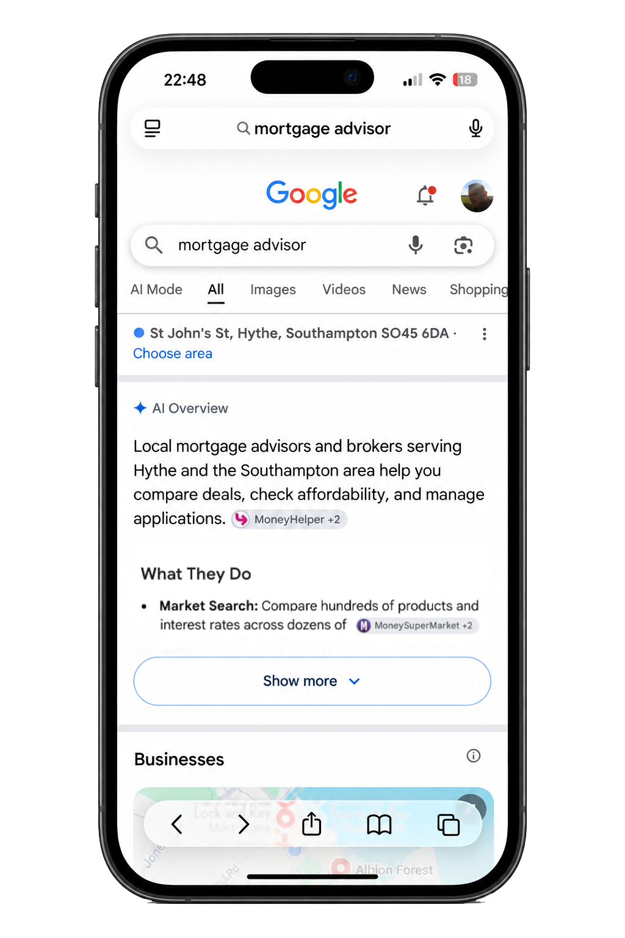
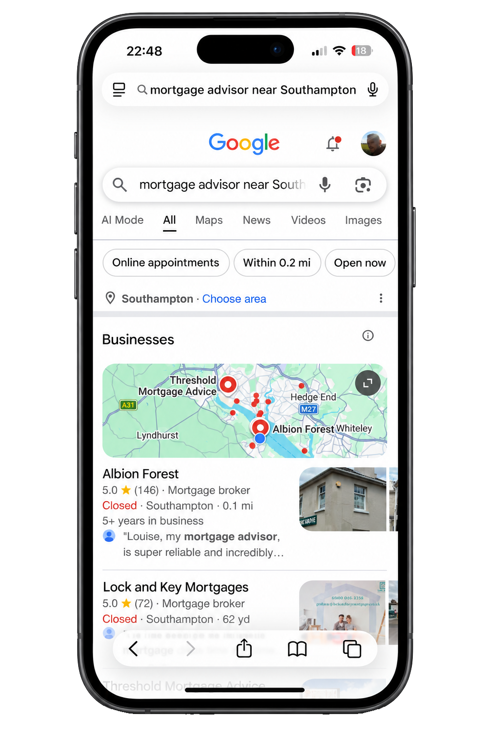
^{THE MACHINE – AI RESULTS}
16 of 49
points where Google's AI answered "mortgage adviser"
And when it does answer, you get a definition, not a recommendation (albeit with sources).
But remember our 35-year-old at 11pm. She doesn’t start with 2 words. She asks real questions first… so I also asked Google one.
Notes:
And now the machine – AI,
For the two-word search, “mortgage adviser”, Google’s AI only answered at sixteen of the forty-nine points. Most of the time, people just get the map.
And when it does give an AI answer, look what you get. [point] A definition. What a mortgage adviser is. Sourced from MoneyHelper and MoneySuperMarket. Not a single local firm.
But remember our 35-year-old at eleven o’clock. She doesn’t type two words. She asks real questions. So I also asked Google one.

Slide 17
THE MACHINE – A REAL CLIENT QUESTION
"First time buyer mortgage advice Southampton"
46 of 49
points where Google's AI recommended named local firms
AI answer naming local firms (46)
AI answer, no firm named (3)
Notes:
So I asked the kind of thing she'd actually type: "first time buyer mortgage advice Southampton". – the type of question a possible client would ask.
This time Google's AI answered everywhere. Forty-nine points out of forty-nine. And at forty-six of them, it didn't just explain. It recommended specific local firms, by name.
So for the questions your clients really ask, the machine is already choosing who to send them to.
ARE YOU ONE OF THOSE FIRMS? THE ONES WHO ARE, ARE MAKING SURE THEIR WEBSITE IS STRUCTURED CORRECTLY
And it gets more direct than that.

Slide 18
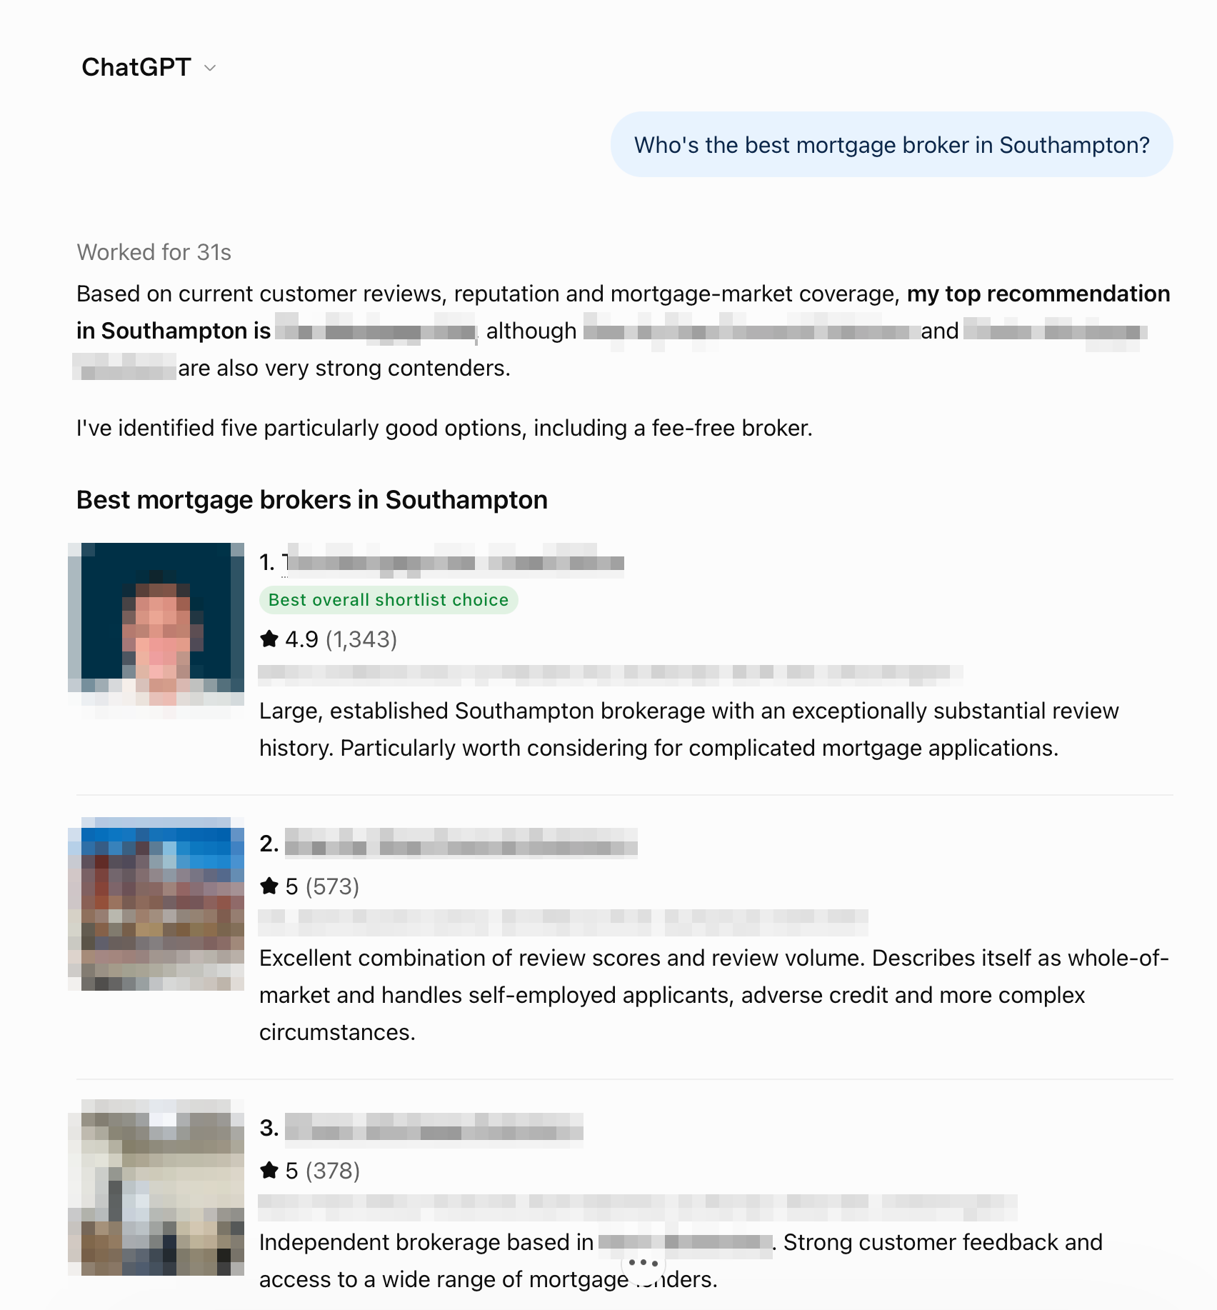
THE MACHINE – WHAT IF THEY ASK CHATGPT?
Another question, this time using ChatGPT
"Who's the best mortgage broker in Southampton?”
"Based on current customer reviews, reputation and mortgage-market coverage…"
How ChatGPT says it chose
Every pick shown with its star rating and review count
Top pick: 4.9 stars from 1,343 reviews
Google’s AI Mode does the same: firms named in all 49 answers, ratings quoted every time Citations, sources, and real life feedback from clients
Data from TrustPilot Unbiased, Facebook, VouchedFor, Google, etc
But people won’t scroll too deep
Notes:
And what if she skips Google and asks ChatGPT the question she really wants answered: who’s the best mortgage broker in Southampton?”
Look at the first line. [point] "Based on current customer reviews, reputation and mortgage-market coverage." That's how it decides. And every firm it recommends comes with a star rating and a review count.
I ran that question through ChatGPT at all forty-nine points. It named firms every single time.
But here's the interesting bit: it looks in different places to Google. Google's AI reads your Google profile. ChatGPT reads Unbiased, VouchedFor, your own website. It even checks Companies House.
Different machines read different homework. If you're not on those sites, ChatGPT can't recommend you.

Slide 19
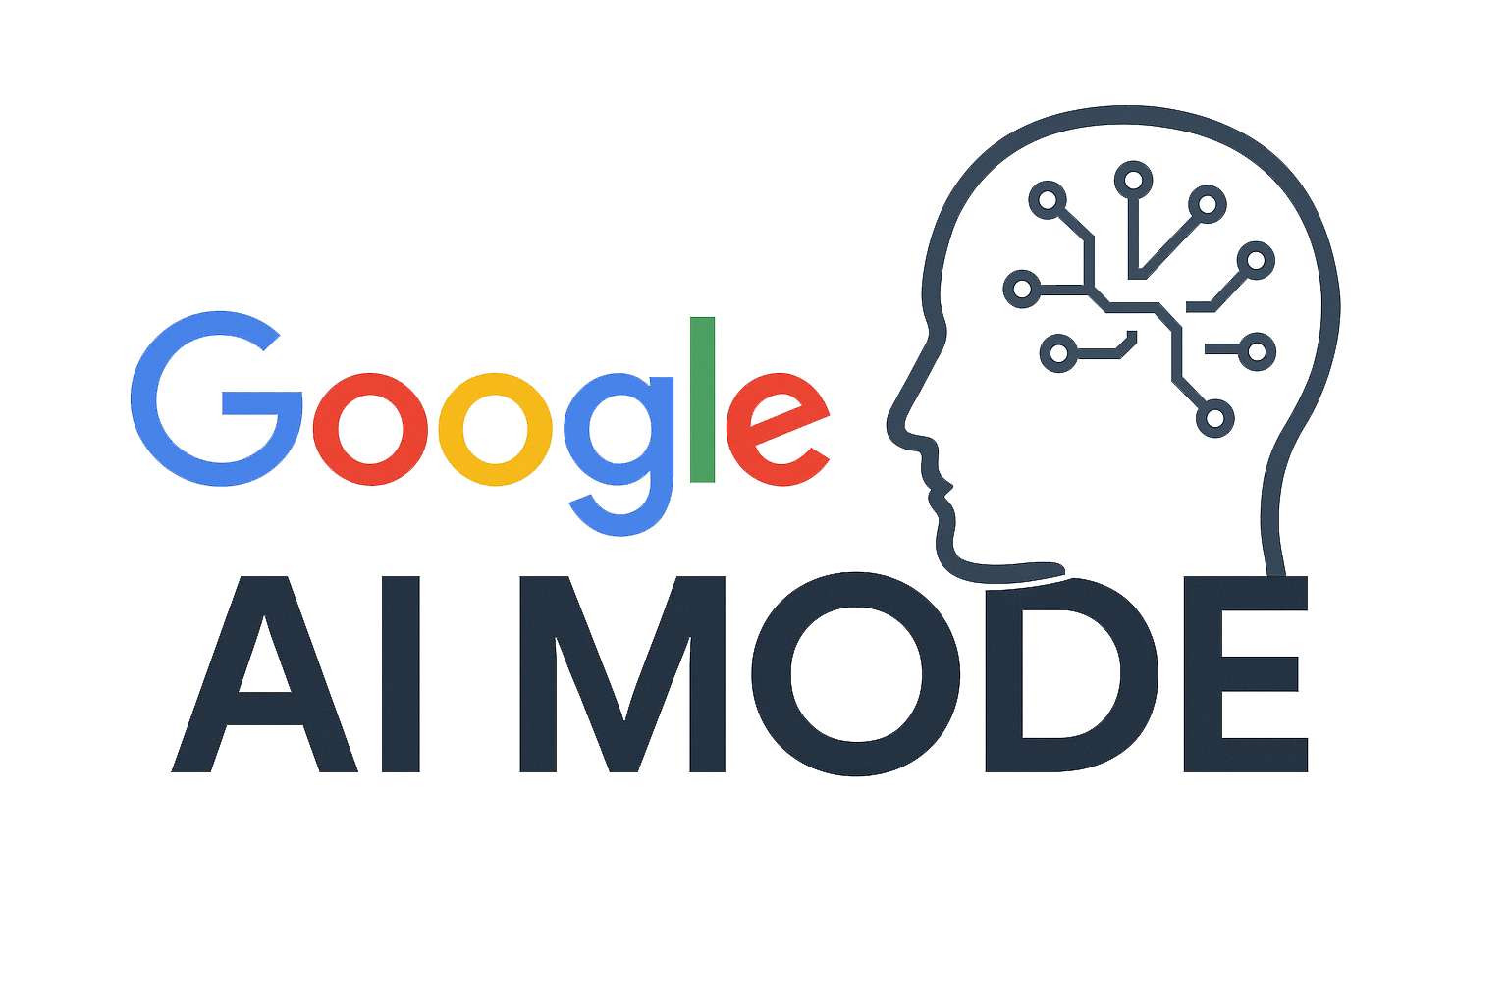
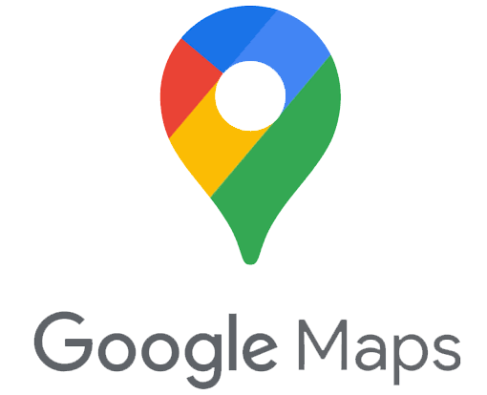

^{THE MACHINE – WHAT IT REWARDS}
Reviews alone don't win the map.
But they do win the AI.
Same firm. 1,350 reviews.
2 of 49
Google Maps: in the top three
42 of 49
Google AI Mode: named
24 of 49
ChatGPT: named
Notes:
Remember the firm with thirteen hundred and fifty reviews? On the map, top three at just two points out of forty-nine.
In Google's AI Mode, named at forty-two. And ChatGPT named them in twenty-four of forty-nine.
Same firm. Same week. The map barely sees them. The machines keep recommending them.
So the map and the machines reward different homework. The map wants a clean, relevant profile close to the searcher. The AI, whether it's Google's or ChatGPT, wants reviews, ratings and clear facts it can quote. You need both. And the good news is, it's the same short list of jobs. I'll give it to you in a minute.

Slide 20
^{THE OPPORTUNITY}
All 3 are winnable.
On the map: one national owns half the city of Southampton
In Google’s AI: the answer changes week to week, and nobody really owns it yet
In ChatGPT: it recommends whoever it finds on Unbiased, VouchedFor, Trustpilot, etc and their own website
All 3 are won on homework, not size
Notes:
I could tell you that’s worrying. It isn’t. It’s the best news anyone in this room will get this week.
On the map, one national owns half the city. In Google’s AI, nobody owns it yet. The answers shift week to week. And ChatGPT? It recommends whoever it can find on Unbiased, VouchedFor and their own website. Most local firms simply aren’t there yet.
None of that is won by being the biggest, or the oldest, or even the best adviser in Southampton. It’s won by doing the homework these machines read. And that homework can be learned.

Slide 21
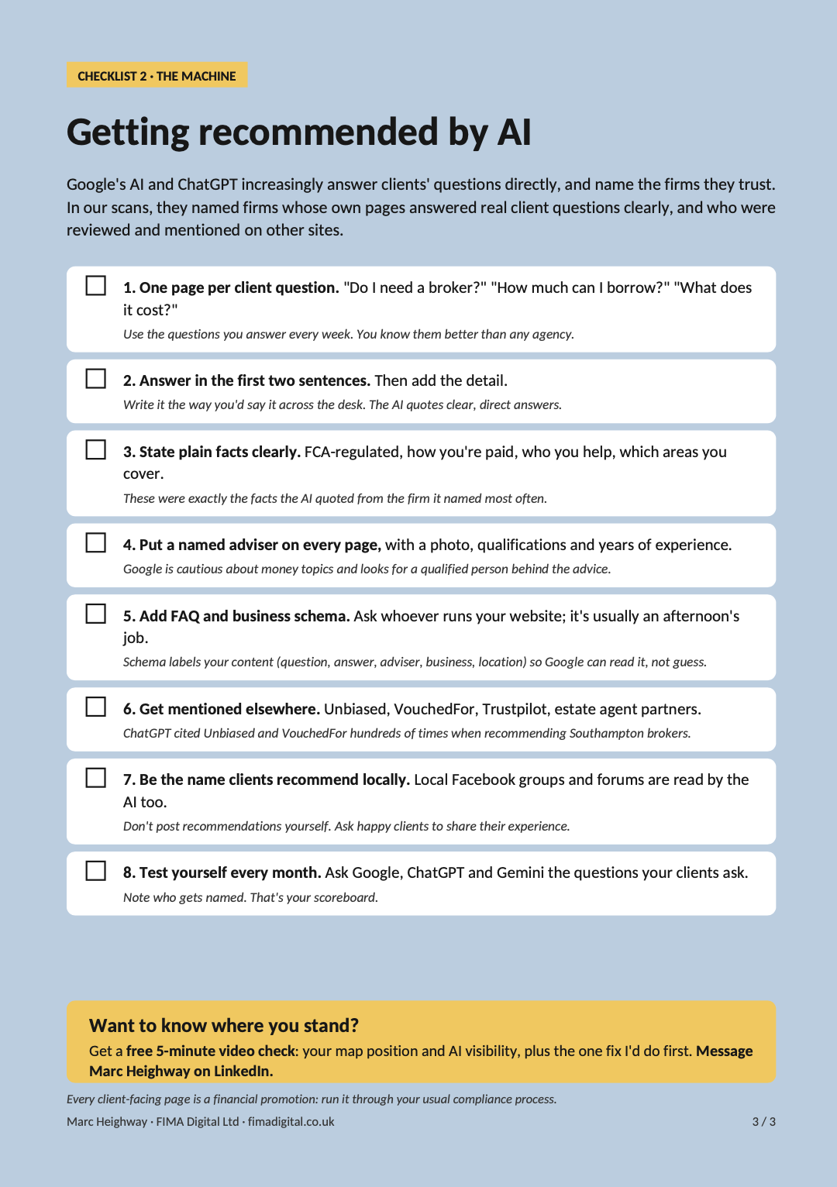
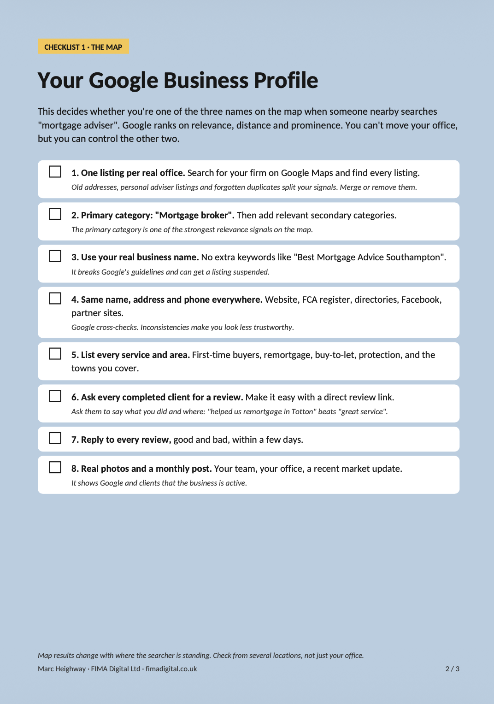
^{TAKE THIS AWAY}
Two checklists you can use on Monday morning.
Your Google Business Profile: win more of the map
Getting recommended by AI, Google and ChatGPT: become the answer
Notes:
So what do you actually do about it? I promised you value, so here it is.
The map and the machines all want the same three things: be easy to quote, be safe to trust, and be clearly local. Two checklists cover all of it. No software, no new website. Things you or your team can start on Monday morning.
The first is your Google Business Profile, which is how you win more of the map. The second is how you get recommended by AI, both Google’s and ChatGPT, which is how you become the answer.
You don’t need to write these down. Just message me on LinkedIn and I’ll send you both, free, along with the Southampton findings.
Connect with me on LinkedIn and send me a message. I’ll send you both checklists, and the first five get a free video check.

Slide 22
^{CHECKLIST 1: THE MAP}
Your Google Business Profile
1. One listing per real office. Find and merge duplicates: old addresses, personal adviser listings.
2. Primary category: "Mortgage broker". Add relevant secondary categories.
3. Your real business name. No keywords stuffed in. Google suspends listings for it.
4. Same name, address and phone everywhere (“citations”): Website, FCA register, Unbiased, VouchedFor, Companies House, Facebook. Google and ChatGPT both cross-check.
5. List every service: first-time buyers, remortgage, buy-to-let, protection, the areas you cover.
6. Ask every completed client for a review: and ask them to say what you did and where.
7. Reply to every review, good and bad, within a few days.
8. Real photos and a monthly post: your team, your office, a recent rate update.
Notes:
Checklist one: your Google Business Profile. This is the map.
One: one listing per real office. I regularly find two or three: an old address, an adviser's personal listing, a duplicate someone made years ago. They split your signals. Merge them.
Two: make sure your primary category is "Mortgage broker". You'd be amazed how many are set to "Financial consultant" or something vaguer.
Three: use your real business name. Don't stuff "Best Mortgage Advice Southampton" into it. Google suspends listings for that.
“Four: your name, address and phone number need to match everywhere they appear. In the trade we call these citations. Your website, the FCA register, Unbiased, VouchedFor, Companies House, Facebook. This one helps the map and the AI. When I looked at where ChatGPT got its recommendations, Unbiased, VouchedFor and Companies House were all near the top. If your details don’t match, it’s less sure you’re the same firm.”
Five: list every service and say which areas you cover.
Six: ask every completed client for a review and ask them to mention what you did and where. "Helped us remortgage in Totton" is worth far more than "great service".
Seven: reply to every review.
Eight: real photos, and a short post once a month. It shows Google, and clients, that someone's home.
None of that costs a penny. It's an afternoon's work. And remember: this is what Google's AI was quoting this week too.

Slide 23
^{CHECKLIST 2: THE MACHINE}
Getting recommended by AI
1. One page per client question. "Do I need a broker?" "How much can I borrow?" "What does it cost?"
2. Answer in the first two sentences. Then the detail. Write it how you'd say it across the desk.
3. State plain facts clearly: FCA-regulated, how you're paid, who you help, where you work.
4. Put a named adviser on every page, with photo, qualifications and years of experience.
5. Add FAQ and business schema. It labels your content so Google can read it, not guess.
6. Get reviewed and recommended elsewhere: Unbiased, VouchedFor, Trustpilot, estate agent partners. ChatGPT used these more than anything else.
7. Be the name clients recommend in local Facebook groups and forums. The AI reads those too.
8. Test yourself monthly. Ask Google, ChatGPT and Gemini your clients' questions. Who's named?
Notes:
Checklist two: getting recommended by AI, Google’s and ChatGPT. This is exactly what the firms they named had in common.
One: one page per client question. Take the ten questions you answer every week and give each its own page.
Two: answer it in the first two sentences. "Can I get a mortgage with one year's accounts? Often, yes. Some lenders will accept one year if you have a strong track record." Then the detail.
Three: state plain facts clearly. That you're FCA-regulated, how you're paid, who you help, which areas you cover. When I looked at what the AI quoted from the firm it named most, it was exactly those facts.
Four: a named adviser on every page, with a photo and qualifications. Google is cautious about money topics. It wants a qualified human behind the advice.
Five: FAQ and business schema. It sounds technical, but it's just labelling. Whoever does your website can add it in an afternoon.
Six: get mentioned elsewhere. Unbiased, VouchedFor, Trustpilot, your estate agent partners' websites. The AI was reading all of those.
Seven: be the name clients recommend in local Facebook groups. The AI was reading those too. You can't post your own recommendations, but you can ask happy clients to.
Eight: test yourself once a month. Ask Google, ChatGPT and Gemini the questions your clients ask, and see who gets named.
And yes, every one of those pages is a financial promotion, so it goes through compliance. That's not a barrier. It's your advantage. Accurate, compliant, local answers are exactly what the AI is looking for.

Slide 24

^{WHAT WINNING LOOKS LIKE}
Same Tuesday. Same questions.
Your name this time.
Your answer, with your firm cited underneath
One of the three names on her map
Trusted before the first call
Notes:
Do those two checklists, and here's what winning looks like.
Same 35 year-old. Same Tuesday night. Same questions. This time, when Google explains whether she needs a broker, it's your words, with your firm cited underneath. And when she types "mortgage adviser", you're one of the three names on her map, not just outside your own office, but across the city.
When she rings you, she already trusts you. You haven't sold her anything. You were simply the one who answered.

Slide 25
^{WHERE DO YOU STAND?}
Free 5-minute video check
Your map position and your AI visibility, for your town
The one fix I'd do first
First 5 requests get a free video check · closes Friday 30 October
EVERYONE GETS THE CHECKLISTS SENT TO THEM AS PDFS
Find me on LINKEDIN – Marc Heighway
Notes:
If you'd like to know where you stand, here's the offer for this room.
I'll record a free five-minute video check of your firm. It'll show you where you appear on the map across your town, whether Google's AI mentions you, and the one fix I'd do first.
I can only do 5 of these properly, so it's the first 5 who request it from me, and it closes on Friday 31 October.

Slide 26
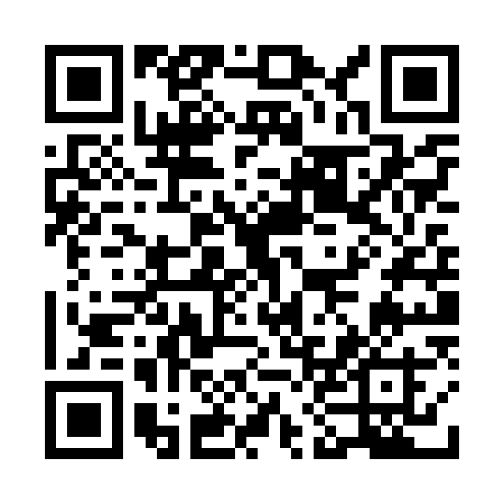

Tonight, someone in Southampton or in the town you operate in, will ask Google about a mortgage.
Make sure the answer is you.
MARC HEIGHWAY
Notes:
Last thing.
Tonight, somebody in Southampton or the town you operate in will ask Google whether they need a mortgage adviser. Right now, the map will probably show them a national firm, and if Google's AI answers at all, it will build its answer from someone's Google profile and website.
Make sure next time, the answer is you. Thank you.
Connect with me on LinkedIn, drop me a line and I’ll send you both checklists, and the first 5 get a free video check.

